Slide 1
The Internet of Things:
A Look Ahead
@robconeybeer
Shasta Ventures
280.vc

Slide 2
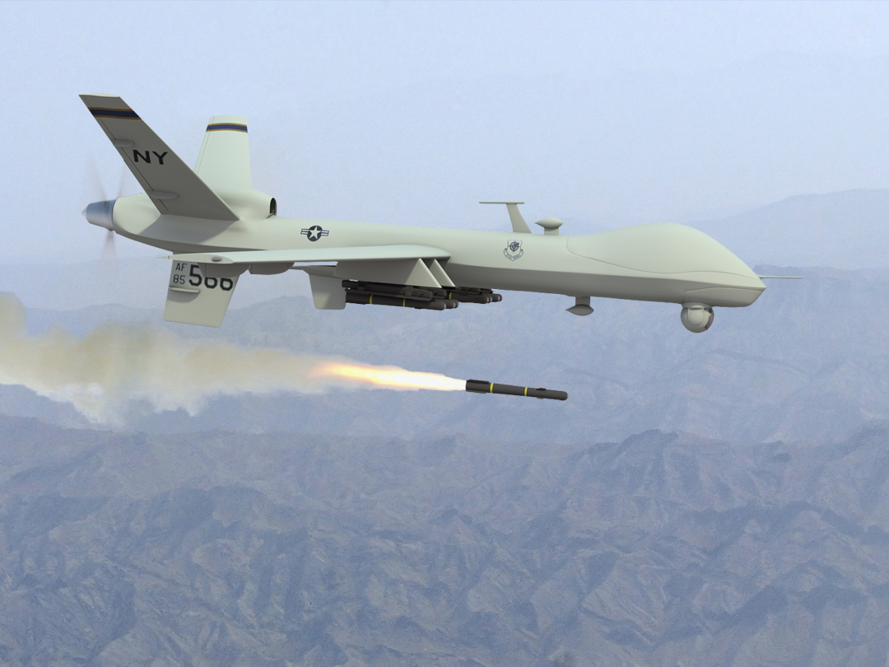
Notes:
INTRO PICTURE—DRONE PREDATOR

Slide 3
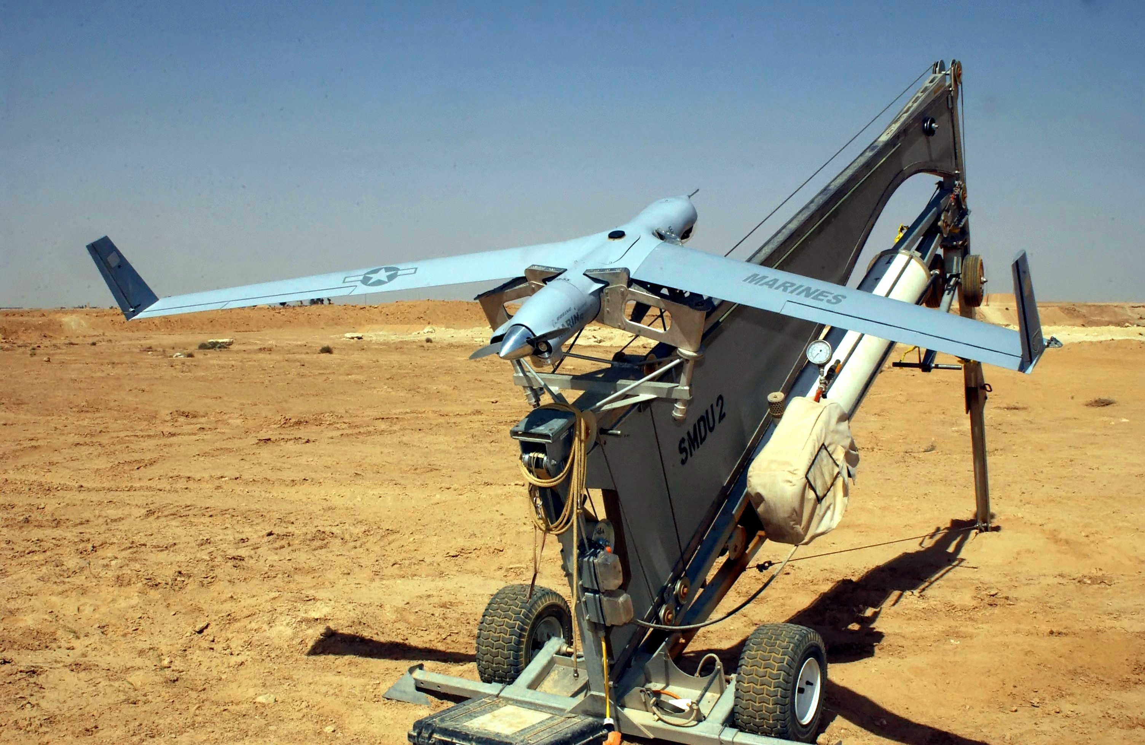
Notes:
SCAN EAGLE UAV CATAPULT LAUNCHER

Slide 4
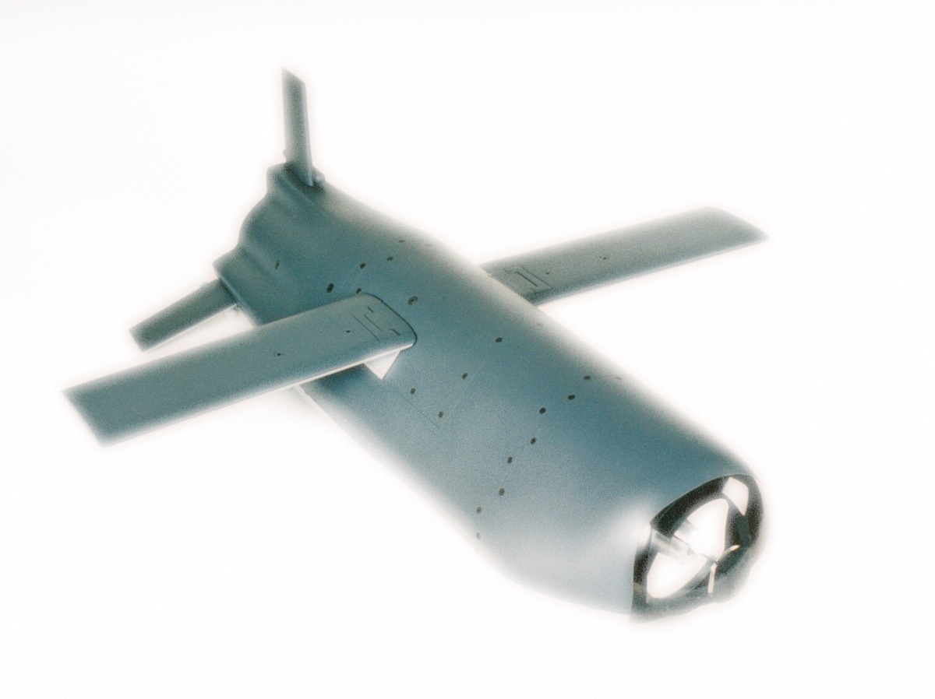

Slide 5
Notes:
BLANK

Slide 6
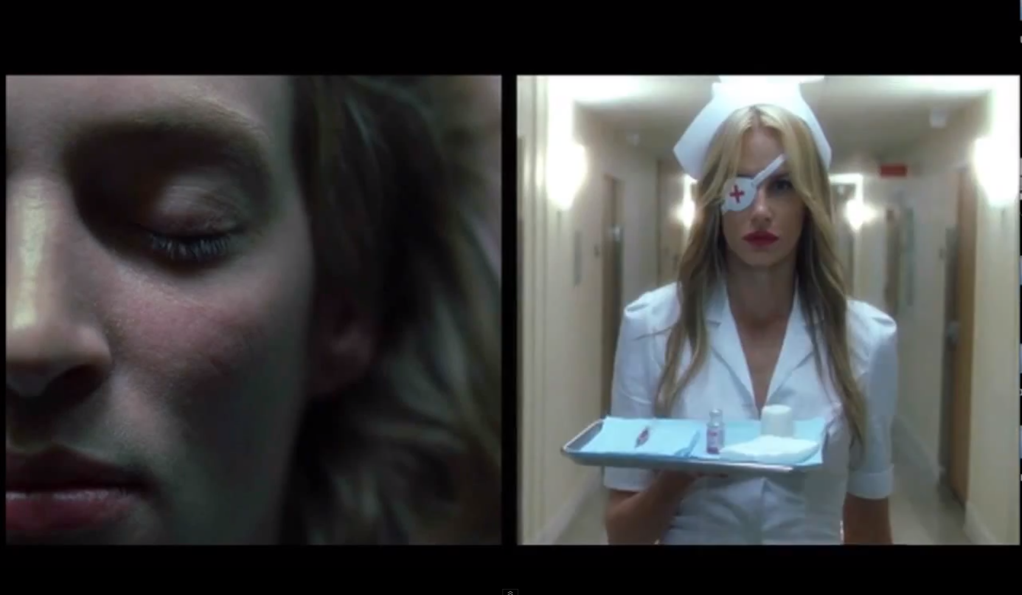
Notes:
Victim of hospital Kill Bill

Slide 7
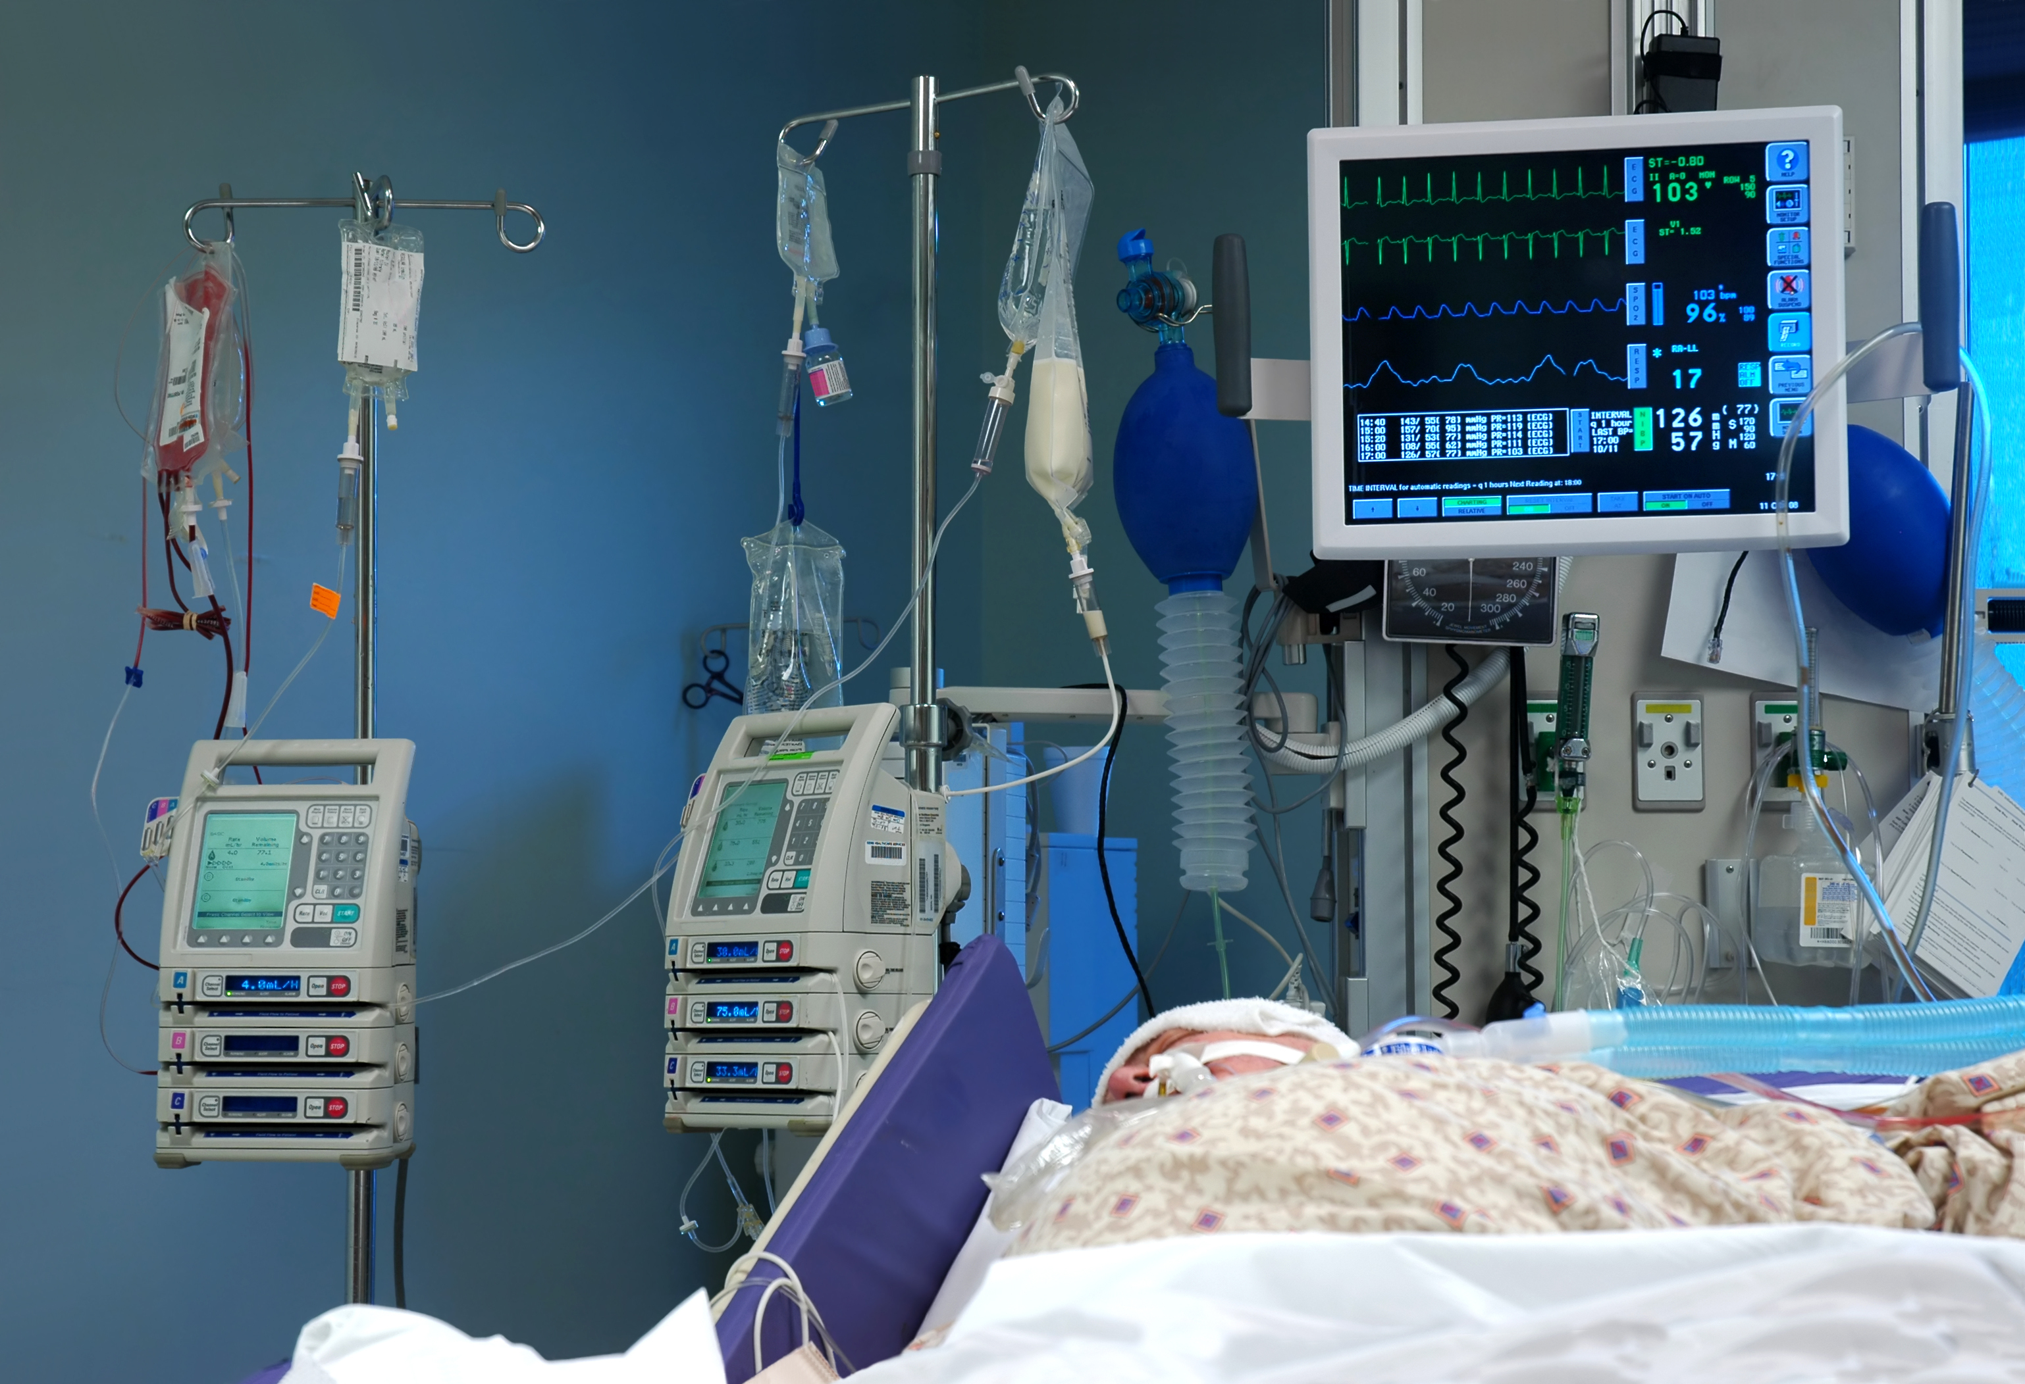
Notes:
ICU WITH EQUIPMENT

Slide 8
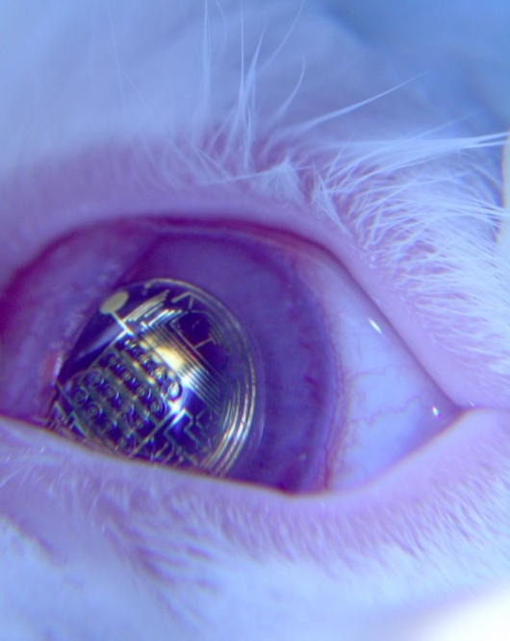
Notes:
LENS OR EYE CLOSEUP

Slide 9
Notes:
BLANK

Slide 10
Notes:
Nest logo

Slide 11
Notes:
BLANK

Slide 12
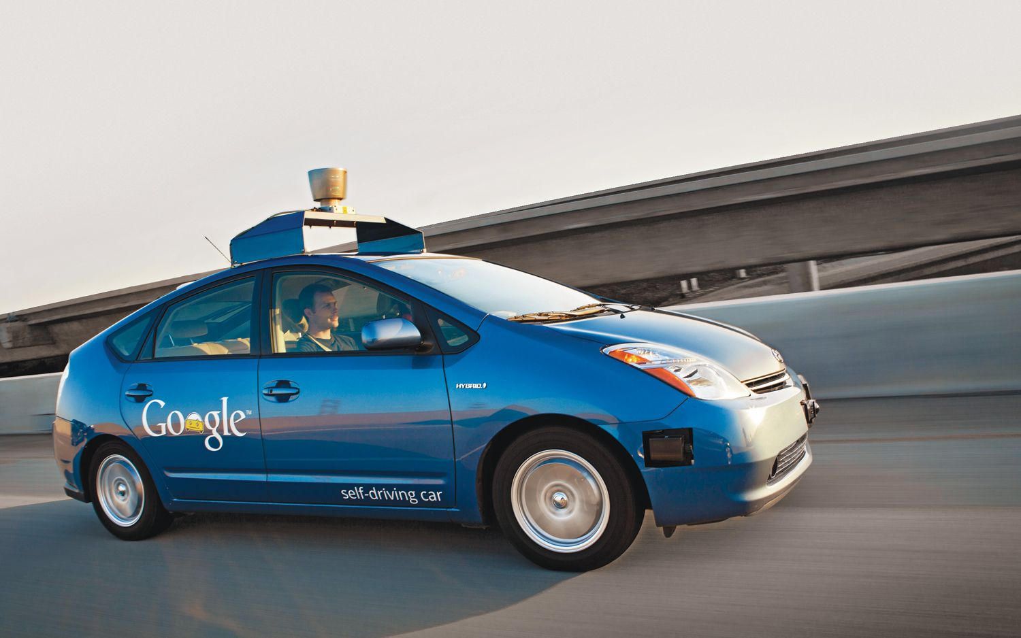
Notes:
Google car Prius

Slide 13
Notes:
BMW track trainer

Slide 14
Notes:
BLANK

Slide 15
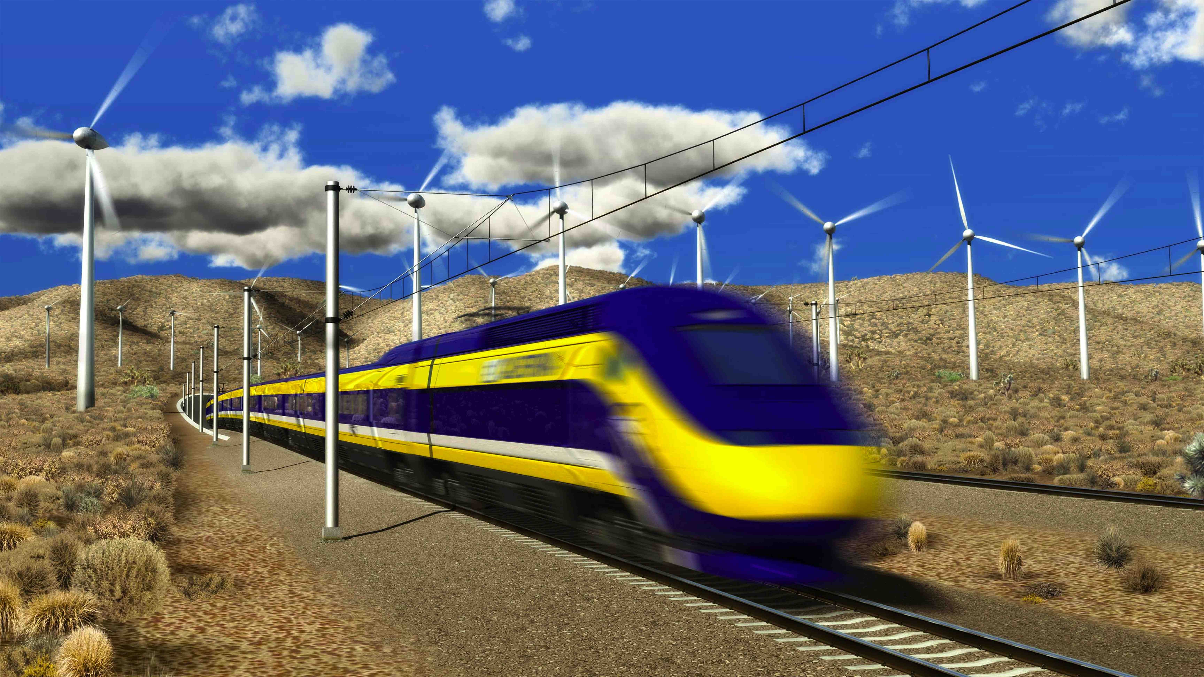
Notes:
CALIFORNIA HIGH SPEED RAIL TRAIN

Slide 16
Notes:
JUST SAY NO TO HIGH SPEED RAIL

Slide 17
Thank You
@robconeybeer
Shasta Ventures
280.vc
Notes:
Use Shasta logo?
Use 280.vc logo?

